Slide 1
Chapter 11: Price and Deliver the Value Offering
Copyright © McGraw-Hill Education. All rights reserved. No reproduction or distribution without the prior written consent of McGraw-Hill Education.
McGraw-Hill Education
Part 4: Price and Deliver the Value Offering

Slide 2
Learning Objectives
Understand the integral role of price as a core component of value.
Explore different pricing objectives and related strategies.
Identify pricing tactics.
Describe approaches to setting the exact price.
Determine discounts and allowances to offer to channel members.
Understand how to execute price changes.
Examine legal considerations in pricing.

Slide 3
Price Is a Core Component of Value
Value is a ratio of the bundle of benefits a customer receives from an offering compared to the costs incurred by the customer in acquiring that bundle of benefits.
Price—or more specifically the customer’s perception of the offering’s pricing—is a key determinant of perceived value.
Developing pricing strategy implies looking at branding and product decisions, service approaches, supply chain, and marketing communication.
Notes:
Pricing decisions cannot be made in a vacuum but rather must consider the whole of the firm’s offering, especially the concurrent decisions the firm is making about branding and products, service approaches, supply chain, and marketing communication. For the marketing manager, pricing is much more than an economic break-even point or a cost-plus accounting calculation. Price is a critical component that plays into a customer’s assessment of the value afforded by a firm and its offerings

Slide 4
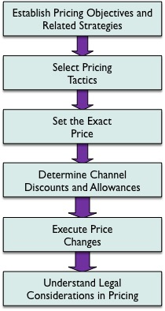
Elements of Managing Pricing Decisions
EXHIBIT 11.1
Link to long alt text description

Slide 5
Establish Pricing Objectives
Pricing objectives are the desired or expected result associated with a pricing strategy.
Pricing objectives must be consistent with other marketing-related objectives (e.g., positioning and branding) as well as with the firm’s overall objectives for doing business.
Notes:
The decision of which pricing objective or objectives to establish is driven by many interrelated factors. As you learn about each of the approaches, keep in mind that most firms attempt to balance a range of issues through their pricing objectives, including internal organization-level goals, internal capabilities, and a host of external market and competitive factors.

Slide 6
Related Strategies: Penetration Pricing
Penetration pricing:
Used to gain maximum market share.
Price sensitive customers.
Firm’s internal efficiencies lead to cost advantages which allows lower price.
Sometimes used for new product introduction.
Be careful with penetration pricing:
Price influences customer perception of quality.
Customers prefer lowering price, not raising it.
Changing price confuses positioning and brand image.
Notes:
Market share is the percentage of total category sales accounted for by a firm. When a firm’s objective is to gain as much market share as possible, a likely pricing strategy is penetration pricing, sometimes also referred to as pricing for maximum marketing share.

Slide 7
Related Strategies: Price Skimming
Price skimming:
Initial high price indicates a strong price-quality relationship.
Used by firms with first-mover advantage with high level of panache and exclusivity (e.g., electronics, pharmaceuticals).
Used effectively in niche markets with few competitors.
If the product moves from a niche to a differentiated product, it is difficult to maintain skimming.
Notes:
In general, skimming can be an appropriate pricing objective within the context of a focus (niche) strategy. By definition, such an approach positions a product for appeal to a limited (narrow) customer group or submarket of a larger market. Because niche market players typically attract fewer and less-aggressive competitors than those employing differentiation strategies within the larger market, a focus strategy can usually support higher prices and the potential for skimming can be extended. The ability to use price skimming declines precipitously, however, if the product migrates from a niche positioning to that of a differentiated product within the larger market

Slide 8
Related Strategies: Profit Maximization and Competitor-Based Pricing
Profit maximization and target ROI:
Bottom-line profit is set and then price to meet the target profit.
Price elasticity of demand (e.g., Will consumers buy at the target ROI price?).
Competitor-based pricing:
At the competitor’s price or slightly above or below.
Price war occur when one competitor tries to gain sales and net market share.
Stability pricing is a neutral set point that doesn’t irk competitors or endanger the value proposition.
Notes:
Profit maximum and target ROI: A bottom-line profit is established first and then pricing is set to achieve the target. Although this approach sounds straightforward, it actually brings up an important reason pricing is best cast within the purview of marketing instead of under the sole control of accountants or financial managers in a firm. When pricing decisions on a given product are made strictly to bolster gross margins, bottom-line profits, or ROI without regard to the short- and long-term impacts of the pricing strategy on other important market- and customer-related elements of success, the product becomes strategically vulnerable. Marketing managers are in the best position to take into account the competitor, customer, and brand image impact of pricing approaches. The idea of pricing based on purely economic models and solely for profit maximization raises important ethical concerns, especially in cases where essential products are in short supply. The latest wonder drugs, building materials after a major disaster, and new technologies needed for emerging markets are but three examples in which pricing for pure profit motive can damage both a firm’s image and ultimately its relationships with customers.
Competitor-based: The logic of competitor-based pricing is quite rational unless (a) it is the only approach considered when making the ultimate pricing decisions or (b) it leads to exaggerated extremes in pricing such that on the high end a firm’s products do not project customer value or on the low end price wars ensue. A price war occurs when a company purposefully makes pricing decisions to undercut one or more competitors and gain sales and net market share.

Slide 9
Related Strategies: Stability Pricing
Stability pricing:
In stability pricing, the firm tries to find a neutral set point that is neither too low to irritate the competition or too high to risk the value proposition with customers.
Can provide a competitive advantage in markets that have rapidly changing prices.
Example: Southwest Airlines bases fares on actual distance traveled rather than load maximization formulas of other airlines. Southwest has only a few stable fares for each flight.
Notes:
Southwest Airlines employs a stability pricing strategy by displaying only five or six fares to a particular destination, with price points based on when the ticket is purchased and the days of the week the customer will be traveling. Unlike most other domestic carriers, Southwest actually bases prices more on the distance of the trip and is less tied to load-maximization formulas in which a fare can change minute by minute depending on ticket sales. The airline’s stability pricing approach has proved highly popular with customers, and it’s been successful for the firm as its seat occupancy rate continues to be among the highest in the industry.

Slide 10
Related Strategies: Value Pricing
Value pricing:
Value pricing overtly attempts to take into account the role of price as it reflects the bundle of benefits sought by the customer.
Considers the whole deliverable and all sources of differential advantage—image, service, product quality, personnel, innovation—that create customer benefit.
Toyota and Honda cars cost more initially but last long, need fewer repairs, are more fuel efficient, and have strong resale value.
Notes:
Value pricing is complex and overarches the other pricing objectives discussed so far. Through value pricing, a marketing manager seeks to ensure that the offering meets or exceeds the customer’s expectations—that is, when he or she does the mental arithmetic that calculates whether the investment in the offering is likely to provide sufficient benefits to justify the cost. Put another way, value pricing considers the whole deliverable and its possible sources of differential advantage—image, service, product quality, personnel, innovation, and many others—the whole gamut of elements that create customer benefit.

Slide 11
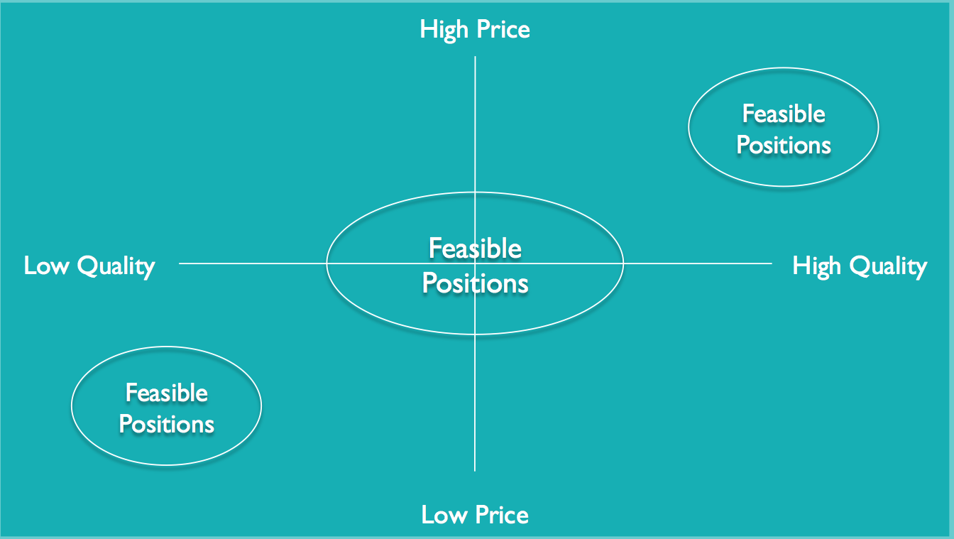
Generic Price-Quality Positioning Map
EXHIBIT 11.3
Link to long alt text description
Notes:
Notice in Exhibit 11.3 that a diagonal range of feasible positioning options exists based on matching price to the benefits achieved. For most products, as long as the customer perceives the ratio of price and benefit to be at least at equilibrium, perceptions of value will likely be favorable. Thus, a poorer-quality product offset by a super-low price can be perceived as a good value just as a higher-quality product at a high price can be.
But what happens when one strays off the favorable diagonal of price/benefit harmony? In the lower-right quadrant—high quality/low price—a penetration strategy might be in play. Or perhaps a firm is taking advantage of its cost leadership by offering a somewhat reduced price. However, over the long run, reducing price too much based on either of these pricing strategies can unnecessarily damage both margins and brand image. Penetration is usually intended to be a temporary strategy, giving the product a chance to gain a strong foot- hold in market share while warding off competition for a time. Michael Porter has long advocated that cost leadership based on value chain efficiencies should not be wholesale translated to low prices—the reason the approach is called cost leadership, not price leadership.
Clearly, operating in the upper-left (high price/low benefits) quadrant can be problematic. Some firms utilize price skimming strategies, especially on product introductions, even when all the bugs have yet to be worked out of the product. New technology products are notorious for having surprises in quality, functionality, and reliability crop up soon after introduction. When this happens, it can be extremely damaging to the value proposition and to the brand. In such cases, from an ethical perspective, one could question the firm’s intent. Did the company rush a product to market to beat an impending entry by competition, pricing it high due to first-mover advantage, all the while knowing that serious quality problems existed? Firms and brands that continually attempt to operate in the high-price/low-benefits quadrant do not survive over the long run as customer trust is damaged.

Slide 12
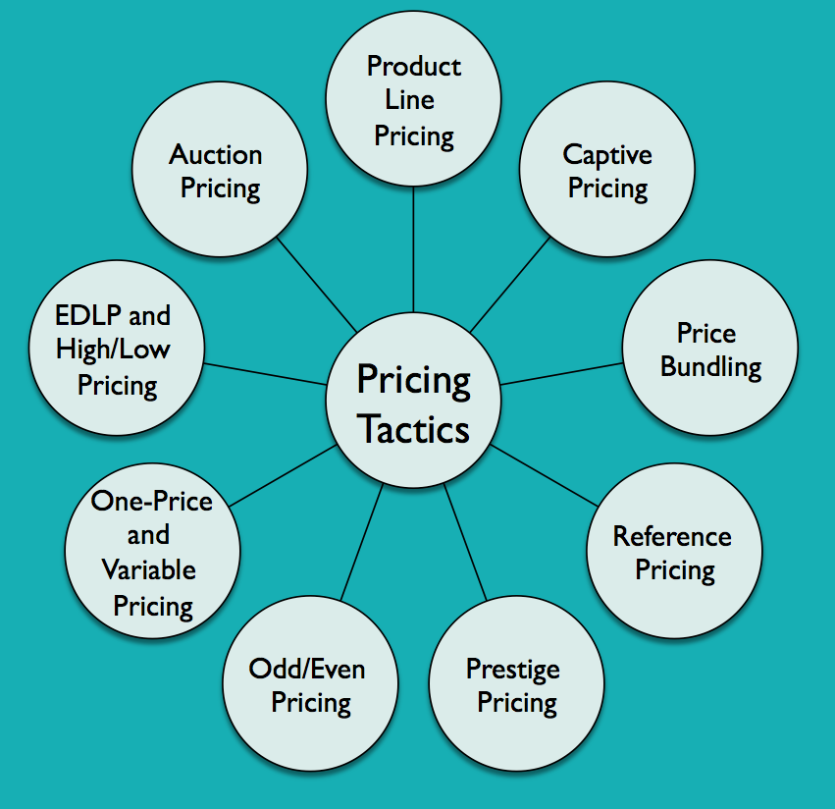
Tactical Pricing Approaches
EXHIBIT 11.4
Link to long alt text description

Slide 13
Pricing Tactics: Product Line and Captive
Product Line Pricing
Price points reflect different benefits at different prices.
Hotel rooms, autos, appliances or different brands like Ritz-Carlton, Marriott, Fairfield Inn, Courtyard.
Captive Pricing
Also called complementary pricing or “razors and blades” like printers and ink cartridges.
In the service sector may be called two-part pricing for firms that charge a monthly fee and then bills for specific services like a gym membership and personal trainer fees.

Slide 14
Pricing Tactics: Bundling and Reference
Price bundling allows customers to buy a package deal at a lower price than if items bought separately (e.g. cable TV, landline phone service, and Internet).
Reference pricing gives the buyer a comparative price.
Store brands on the shelf next to national brands.
Used heavily in B2B price lists.
Notes:
A potential dark side to price bundling is that, in some industries, it can become unclear just what the regular, or unbundled, price is for a given component of a package. The cable/telecommunications industry is regulated to the point that this is less of an issue, but in unregulated industries, unscrupulous firms sometimes set artificially high prices for the sake of pushing customers into buying a package. Beyond legalities, ethical issues sometimes arise with regard to price bundling. For example, car shoppers often find every car on the lot within a given model has many of the same features automatically bundled as add-ons. How many of those features would you buy if you had a choice? The extra features being bundled typically carry much larger margins than the margin on the core vehicle itself. If you special order a car without the bundle, chances are you will be waiting months for it to be delivered to the lot—if the dealer will even order it for you.
Reference pricing is implemented in a number of ways. Sometimes a product catalog might show a manufacturer’s suggested list price next to the actual price the product is offered for in the catalog. In retail stores, in any given product category a private-label product (say, the Walgreens brand for instance) is often purposely displayed on a shelf right next to its national brand equivalent. The retailer hopes the savings realized by the direct price comparison of a bottle of Walgreens’ mint mouthwash versus the bottle of Scope next to it will be enough to stimulate purchase. Reference pricing is very heavily used in B2B price lists, often reflecting price level differences depending on how many items are purchased or reflecting the amount saved by a firm’s special “contract rate” with a vendor versus what a noncontract rate would be.

Slide 15
Pricing Tactics: Prestige and One-Price and Variable
Prestige Pricing
Higher than the competition like luxury goods or ultra-premium products; leads to higher profits (e.g., Voss water).
One-Price Strategy and Variable Pricing
The U.S. market is virtually all one-price with the exception of products like automobiles and real estate that use variable pricing.
In many parts of the world, haggling is expected.
In the United States, B2B and the service sector often uses variable pricing.
Notes:
One rationale for establishing a price skimming objective is prestige pricing—lending prestige to a product or brand by virtue of a price relatively higher than the competition. With prestige pricing, some of the traditional price/demand curves cannot properly predict sales or market response because it violates the common assumption that increasing price decreases volume. From the perspective of financial returns, prestige pricing is a phenomenal approach because, everything else being equal, commanding a premium price reflects directly on margins and bottom line.

Slide 16
Pricing Tactics: Odd/Even and Auction
Odd/Even Pricing
Odd has no whole dollars (e.g., $1.98 or $1.99).
Even is only whole dollars (e.g. $2.00).
Developed before sales tax and credit cards to bolster cash register security and reduce employee theft.
Today is a key element in psychological pricing.
Auction Pricing
More popular due to the Internet (e.g., eBay).
Reverse auctions sellers bid for buyers (e.g., Priceline).

Slide 17
Pricing Tactics: One-Price and Variable; EDLP and High/Low
One-Price Strategy and Variable Pricing
With one-price, there is no bargaining. Everyone pays the same for most goods in the United States.
Variable pricing allows for haggling and is more common around the world.
Everyday Low Pricing (EDLP) and High/Low Pricing
EDLP reduces investment in promotion.
High/low uses heavy promotional pricing and customers wait for the best price.
Notes:
Odd pricing originally came about before the advent of sales taxes and widespread credit card use to bolster cash register security and reduce theft. That is, if a customer brings a $5.00 item to a clerk and presents a $5.00 bill for payment, it was believed that the temptation would be greater for the clerk to simply pocket the bill and not record the sale. It was reasoned that if the clerk had to make change—say a nickel if the item were priced at $4.95—the likelihood was higher that the sale would actually be rung into the cash register. Now, the rationale for odd pricing is very different and it is often regarded as a key element of psychological pricing, or creating a perception about price merely from the image the numbers provide the customer. Studies indicate that at certain important price breaks—$9.99 versus $10.00, $99.95 versus $100.00, and so on— customers mentally process the price as significantly lower because of the reduced digit count in the price point.

Slide 18
Set the Exact Price
Cost-Plus Pricing/Markup on Cost
Markup on Sales Price
Average-Cost Pricing
Target Return Pricing
Notes:
Cost-plus pricing is really just a general heuristic that builds a price by adding a standardized markup on top of costs for an offering, hence the term markup on cost. First an estimate of costs involved must be developed. In accounting courses, you learn that determining costs is no easy task. For example, many different types of costs can be considered, including fixed and variable costs, direct costs and indirect costs, and shared or overhead costs, which might be allocated to the offering on some prorated basis. Nevertheless, once a cost has been established, cost-plus pricing requires the predetermination of some standardized markup percentage that is to be applied based on company guidelines.
In most applications, when a marketing manager simply refers to “markup,” he or she is referring to this calculation—markup on sales price, which uses the sales price as a basis of calculating the markup percentage. This is because most important items on financial reports (gross sales, revenue, etc.) are sales, not cost, figures.
Often pricing decisions are made by identifying all costs associated with an offering to come up with what the average cost of a single unit might be.
To better take into account the differential impact of fixed and variable costs, marketing managers can use target return pricing. First, a few definitions are in order. Fixed costs are incurred over time, regardless of volume. Variable costs fluctuate with volume. And total costs are simply a sum of the fixed and variable costs. To use target return pricing, one must first calculate total fixed costs. Second, a target return must be established.

Slide 19
Discounts and Allowances
Discounts are direct, immediate reductions in price provided to purchasers.
Allowances remit monies to purchasers after the fact.
B2B transactions utilize several types of discounts and allowances.
Notes:
Sellers offer discounts and allowances for a variety of reasons. Paying a bill early, purchasing a certain quantity, purchasing seasonal products during the off-season, and experiencing an overstock on certain products are common rationales for offering various discounts and allowances. At its essence, the approach hopes to impact purchaser behavior in directions that benefit the selling firm by sweetening the buying organization’s terms of sale.

Slide 20
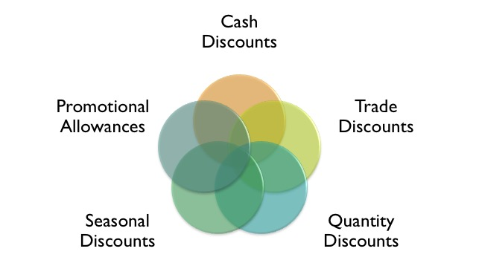
Determine Channel Discounts and Allowances
Link to long alt text description
Notes:
Sellers offer cash discounts to elicit quicker payment of invoices.
Trade discounts, also sometime called functional discounts, provide an incentive to a channel member for performing some function in the channel that benefits seller. Examples include stocking a seller’s product or performing a service related to that product, such as installation or repair, within the channel. Trade discounts are normally expressed as a percentage off the invoice price.
Quantity discounts are taken off an invoice price based on different levels of product purchased. Quantity discounts may be offered on an order-by-order basis, in which case they are noncumulative, or they may be offered on a cumulative basis over time as an incentive to promote customer loyalty. From a legal standpoint, it is essential that quantity discounts are offered to all customers on an equally proportionate basis so that small buyers as well as large buyers follow the same rules for qualification.
Firms often purchase seasonal products many months before the season begins. For example, a retailer might purchase a winter apparel line at a trade show a year before its season, accept delivery in August, begin displaying it in September, yet cold weather may not hit until November or December. To accommodate such lengthy sales processes, firms offer seasonal discounts, which reward the purchaser for shifting part of the inventory storage function away from the manufacturer.
Within a given channel, sellers often want purchasers to help execute their promotional strategies. A consumer products marketer like P&G, for example, depends heavily on wholesalers, distributors, and retailers to promote its brands. When a retailer runs an ad for a P&G brand such as Crest toothpaste, it is nearly always in response to promotional allowances provided by the manufacturer.

Slide 21
Geographic Aspects
Geographic Aspects of Pricing
FOB Pricing
Uniform Delivered Pricing
Zone Pricing
Notes:
The initials FOB stand for free on board, meaning that title transfer and freight paid on the goods being shipped are based on the FOB location. For example, FOB-origin or FOB-factory pricing indicates that the purchaser pays freight charges and takes title the moment the goods are placed on the truck or other transportation vehicle. The greater the distance between shipper and customer, the higher the freight charges to the customer. In contrast, FOB-destination indicates that until the goods arrive at the purchaser’s location, title doesn’t change hands and freight charges are the responsibility of the seller.
Many direct-to-consumer marketers such as Amazon, and Lands’ End practice uniform delivered pricing, in which the same delivery fee is charged to customers regardless of geographic location within the 48 contiguous states. Pricing rates are quoted for other locations, and expedited delivery is generally available for a higher fee.
In a zone pricing approach, shippers set up geographic pricing zones based on the distance from the shipping location. The parcel post system of the U.S. Postal Service is set up this way. Rates are calculated for the various combinations of sending and receiving zones.

Slide 22
Execute Price Changes
A change in an offering’s price—either up or down—can dramatically impact the effectiveness of the overall marketing mix variables in reflecting an offering’s positioning in the eyes of customers.
Firms should conduct market research before changing price to judge customer perceptions.
Just noticeable difference (JND) is the amount of price increase that can be taken without affecting customer demand.
Notes:
In addition to reducing the offering in terms of size or quantity, other nonprice approaches to mitigating the pressure to maintain margins include altering or reducing discounts and allowances, unbundling some services or features from the original offering, increasing minimum order quantities, or simply reducing product quality. However, marketing managers should be cautious when they begin to consider altering the product itself to retain margins; customer response to such tinkering might be negative.

Slide 23
Understand Legal Considerations in Pricing
Legal Considerations
Price Fixing
Price Discrimination
Deceptive Pricing
Predatory Pricing
Fair Trade and Minimum Markup Laws
Notes:
Companies that collude to set prices at a mutually beneficial high level are engaged in price fixing. When competitors are involved in the collusion, horizontal price fixing occurs. The Sherman Act forbids horizontal price fixing, which could result in overall higher prices for consumers since various competitors are all pricing the same to maximize their profits.
Price discrimination occurs when a seller offers different prices to different customers without a substantive basis, such that competition is reduced. The Robinson-Patman Act explicitly prohibits giving, inducing, or receiving discriminatory prices except under certain specific conditions such as situations where proof exists that the costs of selling to one customer are higher than to another (such as making distribution to remote locations) or when temporary, defensive price reductions are necessary to meet competition in a specific local area.
Knowingly stating prices in a manner that gives a false impression to customers is deceptive pricing. Deceptive pricing practices are monitored and enforced by the FTC. Deceptive pricing may take several forms. Sometimes, firms will set artificially high reference prices for merchandise just before a promotion so that an advertised sale price will look much more attractive to customers.50 Or a seller may advertise an item at an unbelievably low price to lure customers into a store, and once the customer arrives refuse to sell the advertised item and instead push a similar item with a much higher price and higher margin. When this occurs and it can be demonstrated that a seller had no true intent to actually make the lower-priced item available for sale, the practice is called bait and switch and is illegal. Finally, the ubiquitous reliance of retailers on scanner-based pricing has opened a plethora of stealth pricing fraud schemes, perpetrated by dishonest retailers who label an item on the shelf sign at a lower price than it is actually priced within the scanner database
A strategy to intentionally sell below cost to push a competitor out of a market, then raise prices to new highs is called predatory pricing. Predatory pricing is illegal but prosecuting it can be very tricky because intent must be proved.
Fair trade laws were popular in the past because they allowed manufacturers to establish artificially high prices by limiting the ability of wholesalers and retailers to offer reduced or discounted prices. Fair trade laws varied greatly from state to state, depending largely on how strong the independent retailer and wholesaler lobby was in a particular locale. These laws protected mom-and-pop operators from the price discounting by chain stores. Closely associated with fair trade laws are minimum markup laws, which require a certain percentage markup be applied to products. In one extreme case in the early 1970s, the State of Oklahoma took legal action against Target Corporation to force the discounter to obey Oklahoma’s minimum markup law that prohibited advertising a wide variety of merchandise for less than a 6 percent profit. This effectively shut down Target’s ability to advertise loss leader products, items (typically paper towels, toilet paper, toothpaste, and the like) sacrificed at prices below cost to attract shoppers to the store.

Slide 24
Alt Text Appendix
All long alt text descriptions are included in this appendix.

Slide 25
Elements of Managing Pricing Decisions
The first element of managing pricing decisions is to establish pricing objectives and related strategies. This is followed by selecting pricing tactics. The next element is setting the exact price. After that comes determining channel discounts and allowances. The next element is executing price changes. The last element is understanding legal considerations in pricing.

Slide 26
Generic Price-Quality Positioning Map
The generic price-quality perceptual map shows quality on the x-axis and price on the y-axis. Quality increases moving to the right. Price increases moving up. In the center is a large oval representing feasible positions. This oval takes up equal area in all four quadrants. The lower-left quadrant, which represents low quality and low price, has a smaller oval marked feasible positions. Another smaller feasible-positions oval appears in the upper-right quadrant, which represents high quality and high price.

Slide 27
Tactical Pricing Approaches
Pricing tactics include the following: product line pricing, captive pricing, price bundling, reference pricing, prestige pricing, odd/even pricing, one-price and variable pricing, EDLP and high/low pricing, and auction pricing.

Slide 28
Determine Channel Discounts and Allowances
The factors used to determine channel discounts and allowances are: cash discounts, trade discounts, quantity discounts, seasonal discounts, and promotional discounts.

